Slide 1

Altcoin Price Trend Prediction Using Machine Learning
Presented By:
“Group H”
31.Doshi Ojas
32.Gandhi Jinendra
33.Ghule Sumati
34.Muttha Manali
Guided By:
Mrs. K. A. Khedikar

Slide 2
Contents
Introduction
Background
Proposed Solution
Working Environment
Methodology
Implementation
Flow Diagrams
Future Work
Conclusion

Slide 3
Introduction
Bitcoin is a crypto currency which is used worldwide for digital payment or simply for investment purposes.
Bitcoin is decentralized i.e. it is not owned by anyone. Transactions made by Bitcoins are easy as they are not tied to any country.
Investment can be done through various marketplaces known as “bitcoin exchanges”.

Slide 4
Background
There are different aspects of the Altcoin such as its price formation, volatility, systems dynamics and economic value. We used the historical price time series for price prediction and trading strategies. As Altcoin evolves, we can expect Altcoin to grow in unexpected ways as new utility is found. Altcoin owners can expect that its usefulness will only increase over time, hence creating a huge opportunity for investment and make huge profits. So we are going to implement this to predict the Altcoin prices.

Slide 5
Proposed system
Here from sites we are taken OHLC (Open, High, Low, Close), Volume in different Altcoin and indicated in Bitcoin.
After all datasets are collected, we train the model by using this dataset and by using current price of Altcoin, predict model predicts the price. We use Linear Regression.
For generating models to predict the price. The models are generated depending on the Open, High, Low, and Close data from Coin Compare.
By using this training model our app is predict the accurate prize of the Altcoin.
With the help of that price user can decide whether to invest or not in Altcoin.

Slide 6
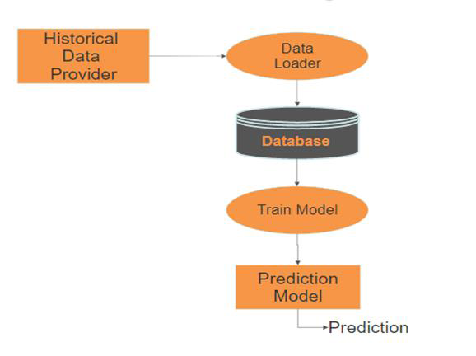
System architecture

Slide 7
Technology Stack
Languages:- Python, Java
Software : Visual Studio code, Android Studio
Database : MySql, Firebase
Method : Tensorflow, Keras, Tensorflow-lite

Slide 8
Implementation
DataLoader :
Fetches the data from Historical Data Provider.
Stores the fetch data in the Database using MySql Server 5.5
Preprocessing :
Read the data from the Database.
Create window size of 31 columns (1st 30 column has 30 days of the price and 31st column has 31st day’s price).
Store that created window in the csv file.

Slide 9
Implementation
Train Model :
For Model creation the Keras is used.
Model has 5 Layers:
Reshape()
2 Layers of LSTM(Long Short Term Memory)
2 Layers of Dense
Created Model is Saved.
Convert Model to Tensorflow-lite Model :
Tensorflow-lite is created to used in the Android app.

Slide 10
Implementation
Model Converted is pass to firebase storage and app interprets the model
After converting the model it is transfer to the firebase storage where the actual created model is stored, which is used for further process.
Prediction Model :
Model is loaded from Firebase Storage load current data from sites .
And pass the 30 days of the data to train model and predict the 31st day’s price.

Slide 11

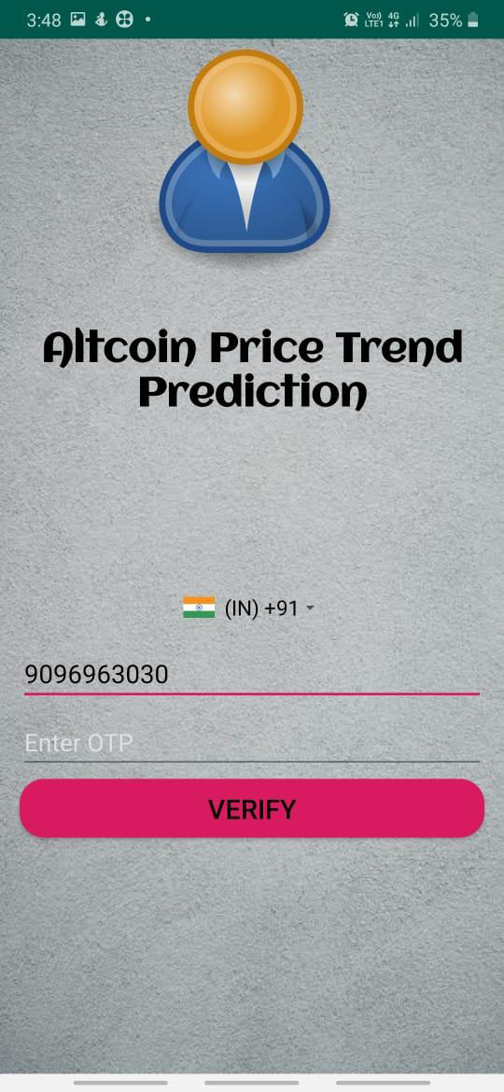
User Interface

Slide 12



Slide 13
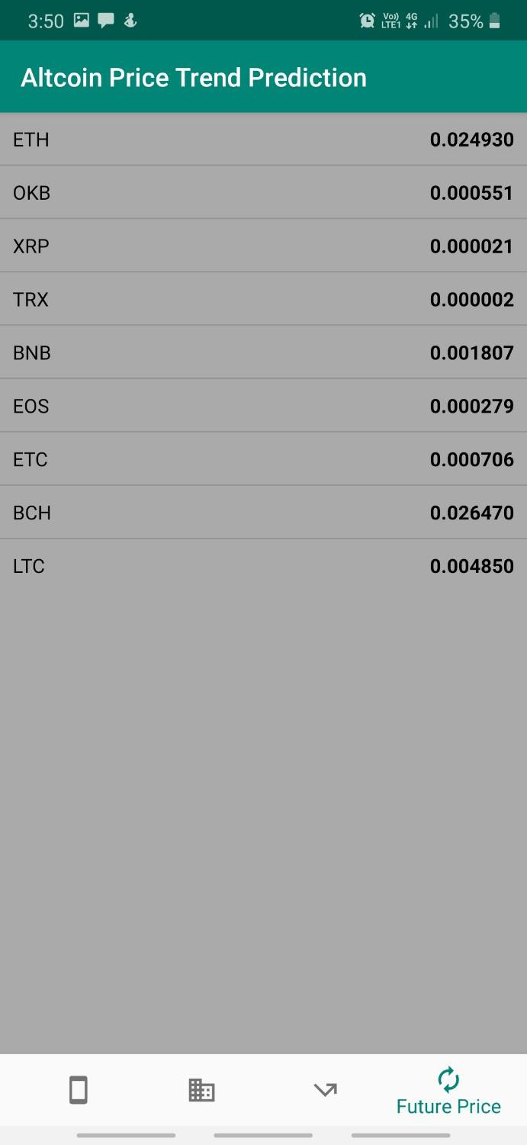
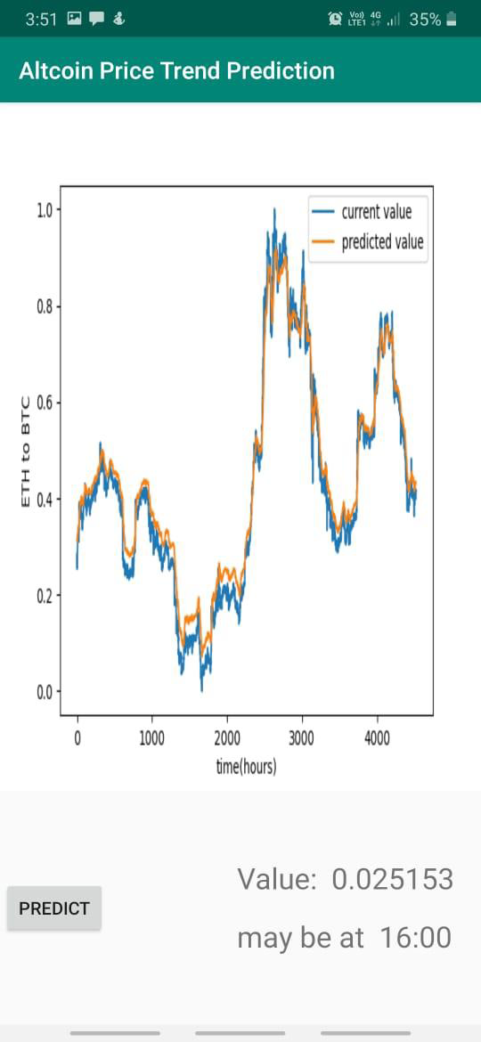

Slide 14
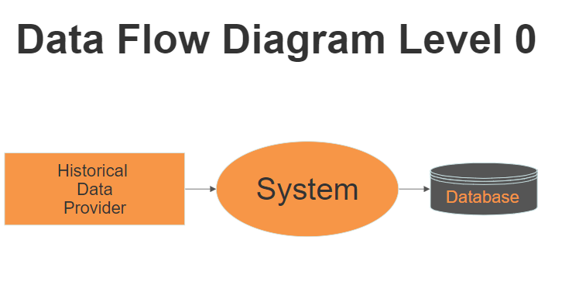
Flow Diagram

Slide 15
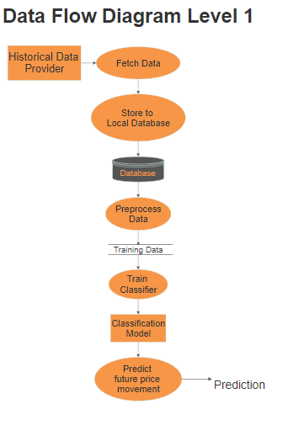

Slide 16
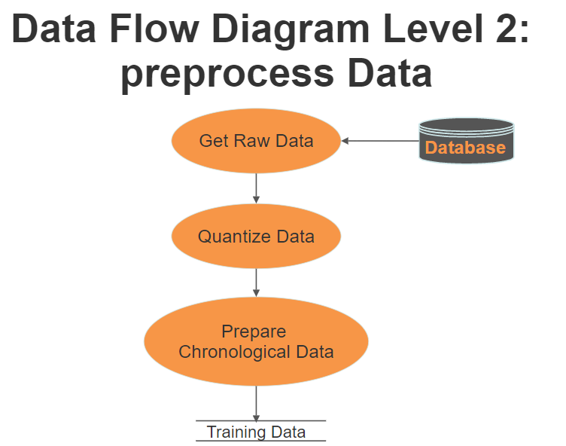

Slide 17
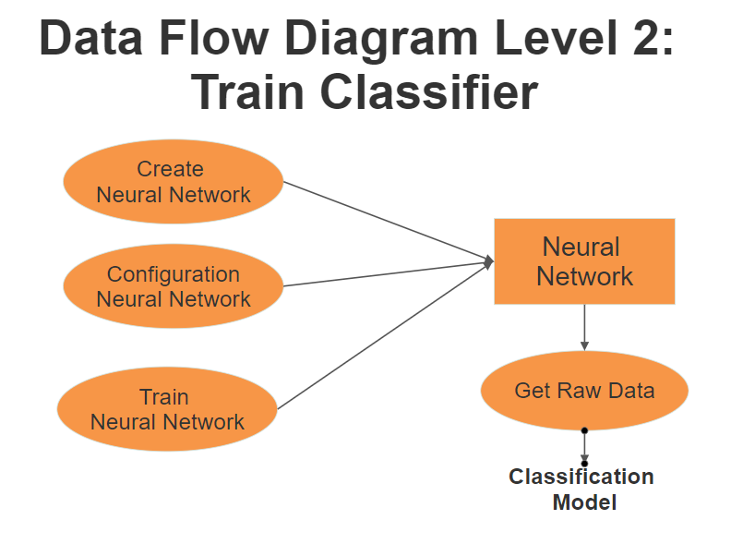

Slide 18
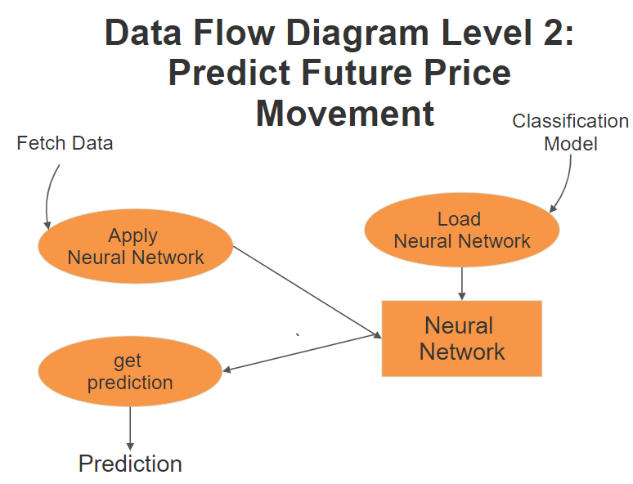

Slide 19
Conclusion
Altcoin is highly volatile and has higher returns than conventional financial trading.
History generally has a way of repeating itself but altcoin has a lot of history which makes it an equal challenge predicting which history will be repeated. It takes more than a study of past trends to get predictions.
The goal of this project is to find a model where we can predict the value of the Altcoin stock considering all the factors which influence the price.

Slide 20
Thank you…

